Slide 1
Pointers

Slide 2
Introduction to Pointers
When we declare a variable some memory is allocated for it. The memory location can be referenced through the identifier “i”. Thus, we have two properties for any variable : its address and its data value. The address of the variable can be accessed through the referencing operator “&”. “&i” gives the memory location where the data value for “i” is stored.

Slide 3
Pointers
What is pointer?
A variable that can hold an Address
A pointer variable is one that stores an address. We can declare pointers as follows int* p; .This means that p stores the address of a variable of type int.
Related operators:
* : can be used in two ways
In declaration : read as pointer, e.g., int *p;
In accessing : read as content of, e.g., x = *p;
& : returns LValue (address) of a variable
Read as address of

Slide 4
Declaring Pointer Variables
Syntax:
Examples:
int *p;
char *ch;
These statements are equivalent:
int *p;
int* p;
int * p;
countPtr
count
7

Slide 5
Pointer Variable Declarations and Initialization
Pointer declarations
* used with pointer variables
int *myPtr;
Declares a pointer to an int (pointer of type int *)
Multiple pointers, multiple *
int *myPtr1, *myPtr2;
Can declare pointers to any data type
Initialize pointers to 0, NULL, or an address
0 or NULL - points to nothing (NULL preferred)

Slide 6
Assignment of Pointer Variables
A pointer variable has to be assigned a valid memory address before it can be used in the program
Example:
float data = 50.8;
float *ptr;
ptr = &data;
This will assign the address of the memory location allocated for the floating point variable data to the pointer variable ptr. This is OK, since the variable data has already been allocated some memory space having a valid address

Slide 7
Assignment of Pointer Variables (Cont ..)
float data = 50.8;
float *ptr;
ptr = &data;
FFF0
FFF1
FFF2
FFF3
data
FFF4
50.8
FFF5
FFF6

Slide 8
Assignment of Pointer Variables (Cont ..)
float data = 50.8;
float *ptr;
ptr = &data;
ptr
FFF0
FFF1
FFF2
FFF3
data
FFF4
50.8
FFF5
FFF6

Slide 9
Assignment of Pointer Variables (Cont ..)
float data = 50.8;
float *ptr;
ptr = &data;
ptr
FFF0
FFF4
FFF1
FFF2
FFF3
data
FFF4
50.8
FFF5
FFF6

Slide 10
Assignment of Pointer Variables (Cont ..)
Don’t try to assign a specific integer value to a pointer variable since it can be disastrous
float *ptr;
ptr = 120;
You cannot assign the address of one type of they are both integrals
int data = 50;
float *ptr;
ptr = &data;

Slide 11
Pointer Operators
& (address operator)
Returns address of operand
int y = 5;
int *yPtr;
yPtr = &y; //yPtr gets address of y
yPtr “points to” y
y
yptr
y
yPtr
5
500000
600000
600000
5
Address of y is value of yptr

Slide 12

Dereferencing Operator (*)
When used as a unary operator, * is the dereferencing operator or indirection operator
Refers to object to which its operand points
Example:
To print the value of x, using p:
To store a value in x, using p:

Slide 13
Pointer Examples
int x = 70, y = 80, z[4] = {10, 20, 30, 40 };
int *ip; // int pointer ip
ip = &x; // ip is assigned to address of x
*ip = 200; // content of ip is assigned to 200
y = *ip; // y is assigned to content of ip
ip = &z[2];
*ip = *ip + 20; // same as *ip += 20;
y = *ip+1;
70
x :
4892
200
200
80
y :
4894
51
Z, Z[0] :
4896
10
Z[1] :
4898
20
50
Z[2] :
4900
30
Z[3] :
4902
40
????
4892
ip :
4904
4900

Slide 14
Pointer Examples
int x = 100;
int *p1 = &x;
cout << "&x == " << &x << " x == " << x << endl << "p1 == " << p1 << " *p1 == " << *p1 << endl;
*p1 += 20;
cout << "&x == " << &x << " x == " << x << endl << "p1 == " << p1 << " *p1 == " << *p1 << endl;
Output
&x == 0x7fff7e60f41c x == 100
p1 == 0x7fff7e60f41c *p1 == 100
&x == 0x7fff7e60f41c x == 120
p1 == 0x7fff7e60f41c *p1 == 120

Slide 15
const and Pointers
const int w=20;
int x, y;
const qualifier can be used with pointers in three ways:
Prohibit a pointer from changing its content
const int *p1 = &w;
// p1 can point to (non-)const int
*p1 = 200;
// invalid : content can’t change
p1 = &x;
// OK. p1 points to x (non-const)

Slide 16
const and Pointers
Prohibit a pointer from changing its reference:
int * const p3 = &x; // must be initialized at creation
p3 = &y; // invalid: reference can’t change
*p3 = 123; // OK. changes value of x
Prohibit a pointer from changing both reference & content:
const int * const p4 = &w;
// must be initialized at creation & point to const int

Slide 17
Relationship Between Arrays and Pointers
array names can be used as pointers, and vice-versa.

Slide 18
Program
// This program shows an array name being dereferenced
// with the * operator.
#include <iostream>
void main(void)
{
short numbers[] = {10, 20, 30, 40, 50};
cout << "The first element of the array is ";
cout << *numbers << endl;
}
Output:
The first element in the array is 10

Slide 19
Figure
numbers[0]
numbers[1]
numbers[2]
numbers[3]
numbers[4]
numbers
(numbers+1)
(numbers+2)
(numbers+3)
(numbers+4)

Slide 20
Program
// This program processes the contents of an array. Pointer
// notation is used.
#include <iostream.h>
void main(void)
{
int numbers[5];
cout << "Enter five numbers: ";
for (int count = 0; count < 5; count++)
cin >> *(numbers + count);
cout << "Here are the numbers you entered:\n";
for (int count = 0; count < 5; count++)
cout << *(numbers + count)<< " ";
cout << endl;
}

Slide 21
Dynamic Variable
Variables that are created during program execution are called dynamic variables.
With the help of pointers, C++ creates dynamic variables.
C++ provides two operators, new and delete, to create and destroy dynamic variables, respectively.
When a program requires a new variable, the operator new is used.
When a program no longer needs a dynamic variable, the operator delete is used.
In C++, new and delete are reserved words

Slide 22
Operator new
The operator new has two forms: one to allocate a single variable and another to allocate an array of variables. The syntax to use the operator new is:
in which intExp is any expression evaluating to a positive integer.
The operator new allocates memory (a variable) of the designated type and returns a pointer to it—that is, the address of this allocated memory. Moreover, the allocated memory is uninitialized.
p = new int;
This statement creates a variable during program execution somewhere in memory and stores the address of the allocated memory in p. The allocated memory is accessed via pointer dereferencing namely, *p.
Similarly, the statement:
q = new char[16];
creates an array of 16 components of type char and stores the base address of the array in q.

Slide 23
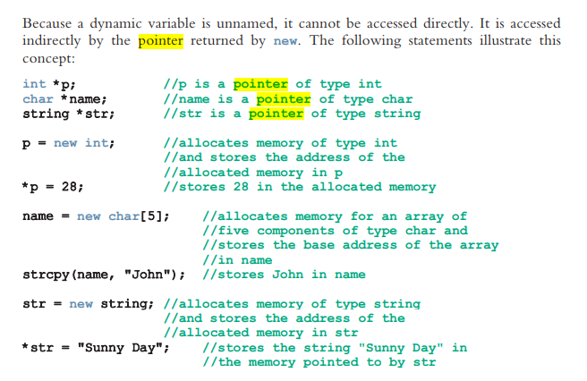

Slide 24
Operator delete
Suppose you have the following declaration:
int *p;
This statement declares p to be a pointer variable of type int. Next, consider the
following statements:
p = new int; //Line 1
*p = 54; //Line 2
p = new int; //Line 3
*p = 73; //Line 4

Slide 25
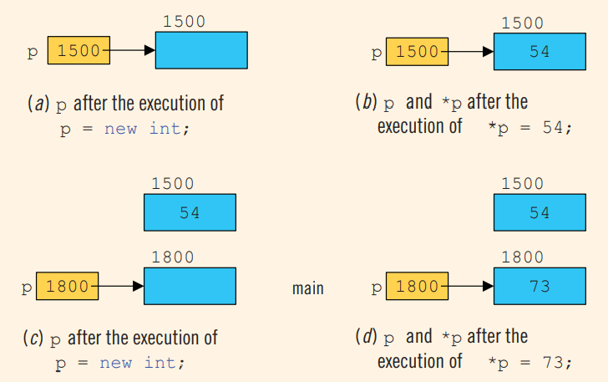

Slide 26
Memory leak
Now the obvious question is what happened to the memory space 1500 that p was pointing to after execution of the statement in Line 1. After execution of the statement in Line 3, p points to the new memory space at location 1800. The previous memory space at location 1500 is now inaccessible. In addition, the memory space 1500 remains as marked allocated. In other words, it cannot be reallocated. This is called memory leak. That is, there is an unused memory space that cannot be allocated

Slide 27
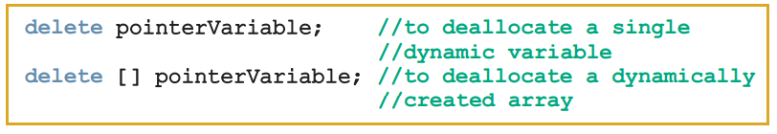
How to avoid memory leak
When a dynamic variable is no longer needed, it can be destroyed; that is, its memory can be deallocated.
operator delete is used to destroy dynamic variables. The syntax to use the operator delete has two forms
delete p;
delete [] name;
delete str

Slide 28
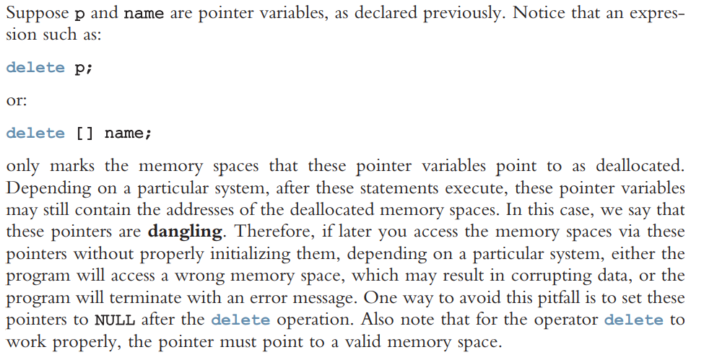

Slide 29
Operations on Pointer Variables
The operations that are allowed on pointer variables are the assignment and relational operations and some limited arithmetic operations.
The value of one pointer variable can be assigned to another pointer variable of the same type.
Two pointer variables of the same type can be compared for equality, and so on.
Integer values can be added and subtracted from a pointer variable.
The value of one pointer variable can be subtracted from another pointer variable

Slide 30
Operations on Pointer Variables
For example, suppose that we have the following statements:
int *p, *q;
The statement: p = q;
copies the value of q into p. After this statement executes, both p and q point to the same memory location. Any changes made to *p automatically change the value of *q, and vice versa
The expression:
p == q
evaluates to true if p and q have the same value—that is, if they point to the same memory location.
Similarly, the expression:
p != q evaluates to true if p and q point to different memory locations

Slide 31
Arithmetic operations on Pointers
int *p;
double *q;
char *chPtr;
the size of the memory allocated for an int variable is 4 bytes, a double variable is 8 bytes, and a char variable is 1 byte’
The statement: p++; or p = p + 1; increments the value of p by 4 bytes because p is a pointer of type int.
q++;
chPtr++;
increment the value of q by 8 bytes and the value of chPtr by 1 byte, respectively.

Slide 32
Arithmetic operations on Pointers
The increment operator increments the value of a pointer variable by the size of the
memory to which it is pointing. Similarly, the decrement operator decrements the value
of a pointer variable by the size of the memory to which it is pointing.
Moreover, the statement:
p = p + 2;
increments the value of p by 8 bytes
Thus, when an integer is added to a pointer variable, the value of the pointer variable is incremented by the integer times the size of the memory that the pointer is pointing to. Similarly, when an integer is subtracted from a pointer variable, the value of the pointer variable is decremented by the integer times the size of the memory to which the pointer is pointing

Slide 33
Dynamic Arrays
It would be helpful if, during program execution, you could prompt the user to enter the size of the array and then create an array of the appropriate size. This approach is especially helpful if you cannot even guess the array size. In this section, you will learn how to create arrays during program execution and process such arrays.
An array created during the execution of a program is called a dynamic array. To create a dynamic array, we use the second form of the new operator.
The statement:
int *p;
declares p to be a pointer variable of type int. The statement:
p = new int[10];
allocates 10 contiguous memory locations, each of type int, and stores the address of the
first memory location into p.

Slide 34
Dynamic Arrays (Continue)
In other words, the operator new creates an array of 10 components of type int, it returns the base address of the array, and the assignment operator stores the base address of the array into p
*p = 25;
stores 25 into the first memory location, and the statements:
p++; //p points to the next array component
*p = 35 store 35 into the second memory location
C++ allows us to use array notation to access these memory locations.
For example, the statements:
p[0] = 25; p[1] = 35;
store 25 and 35 into the first and second array components, respectively.

Slide 35
In int list[5];
An array name is a constant pointer
If p is a pointer variable of type int, then the statement:
p = list;
copies the value of list, which is 1000, the base address of the array, into p. We are allowed to perform increment and decrement operations on p now

Slide 36
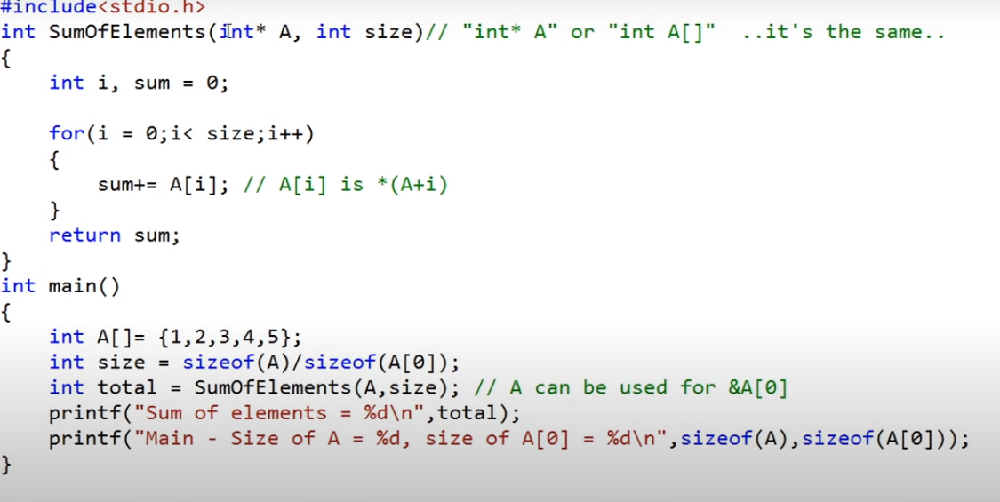
Array to Function as parameters
Notes:
Sum=sum+A[i]

Slide 37
Swapping Using pointers
Class activity

Slide 38
Functions Returning Pointers
int* fun()
{
int A = 10;
return (&A);
}
int main()
{
// Declare a pointer
int* p;
// Function call
p = fun();
cout<<p;
cout<<*p;
return 0;

Slide 39
#include <iostream>
using namespace std;
int* fun()
{
static int A = 10;
A++;
return (&A);
}
int main()
{
int* p;
p = fun();
cout << p<<endl;
cout << *p<<endl;
return 0;
}

Slide 40
Functions Returning Pointers
#include <iostream>
using namespace std;
int* biger(int&, int&);
void main()
{
int num1, num2, * c;
cout << "Enter two integers\n";
cin >> num1 >> num2;
c = bigger(num1, num2);
cout << "The bigger value = " << *c;
}
int* biger(int& x, int& y)
{
if (x > y)
{
return(&x);
}
else
{
return(&y);
}
}

